Slide 1

Network Intrusion Detection System using neural networks
H

Slide 2
CONTENT:
PROBLEM STATEMENT
INTRODUCTION
LITERATURE SURVEY
ALGORITHMS PROPOSED
IMPLEMENTATION
MODEL STRUCTURE USED
STATISTICAL MEASURES
DATA FOR EXPERIMENTATION
OBTAINED RESULT
FUTURE SCOPE
CONCLUSION
REFERENCES

Slide 3
PROBLEM STATEMENT:
The goal of a Network Intrusion Detection System (NIDS) is to alert a system administrator each time an intruder tries to penetrate the network. A misuse NIDS defines attacks via a table of malicious signatures: if an ongoing activity matches a signature in the table, an alarm is raised. Thousands of organizations depend upon such systems because they are simple to understand, enable administrators to customize the signature database, and provide concrete information about the events that have occurred.

Slide 4
INTRODUCTION:
Network Intrusion detection system performs the classification between normal and malicious connection using deep neural networks. Intrusion can be of many types. Like, anybody trying to gain unauthorized access to the network. Virus, Trojans and worms replicating in the network, sending specially crafted packets to exploit any specific vulnerability. Attacks that would make the services unresponsive even for the legitimate clients. Some types of Intrusion/Attacks are: Denial of service attacks, Probe attack: Searching ports an services. NMAP and ZENMAP etc.
Intrusion Detection System can also be used to monitor network traffic, thereby detecting if a system is being targeted by a network attack such as a denial of service attack. Intrusion detection system (IDS) is usually installed to complement the firewall. Intrusion detection system detect attacks as they happen. It performs Real-time monitoring of networks. It provides information about attacks that have succeeded. It performs forensic analysis. For passive systems it performs monitoring and reporting. Whereas for active systems it adapts the corrective measures.
NSL-KDD dataset has nine type of attacks category known as the Analysis, Fuzzers, Backdoors, DoS Exploits, Reconnaissance, Generic, Shellcode, and Worms. NSL-KDD is a data set suggested to solve some of the inherent problems of the KDD'99 dataset adding U2R and R2L attacks.

Slide 5
LITERATURE SURVEY:
Gone through blogs articles and research papers and chose the one that suits best for our use case.
Mainly there are two models of Machine Learning which is used for classification between normal and malicious connection requests i.e. SHALLOW MODEL,DEEP LEARNING MODEL.
There isn't really a consensus on the definition of a shallow neural network but a neural network with one hidden layer is considered a shallow neural network whereas a network with many hidden layers and a large number of neurons in each layer is considered a deep neural network.
Also, unlike a shallow neural network which takes only input as vectors, deep neural networks are able to take raw data such as images and text and automatically extract the necessary features to learn the data better.
Hence, we decided to move on with deep learning model.

Slide 6
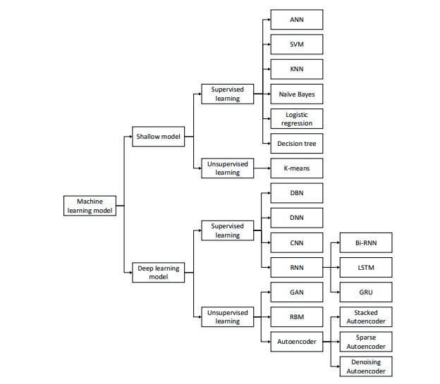
ALGORITHMS PROPOSED:
We will use DNN based model

Slide 7

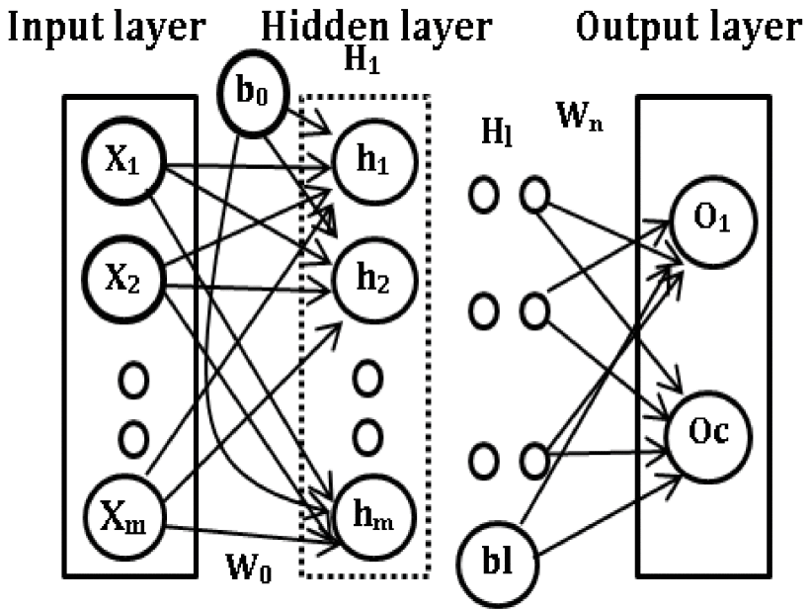



We are using DNN for intrusion detections

Slide 8
IMPLEMENTATION:
NSL-KDD,UNSWNB15 Dataset
Data preprocessing
Feature extraction
no
yes
Feature reduction
Normalization
Training and testing
Result Evaluation

Slide 9
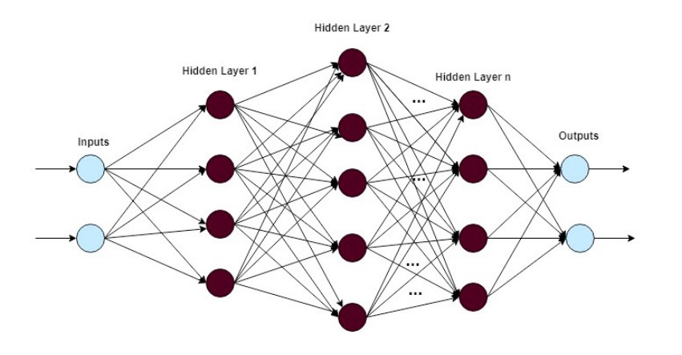
Model Structure used:
Input layer :19 hidden layers:7(800,500,400,300,200,100,50)
output layer:10

Slide 10
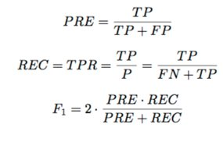
Statistical measures
The following terms are used for determining the quality of the classification models:
TP/N = True Positive/Negative
FP/N = False Positive/Negative
TPR = True Positive Rate
PRE = Precision
REC = Recall

Slide 11
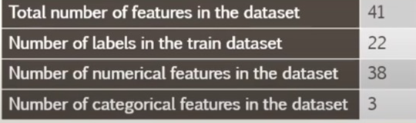
DATA FOR EXPERIMENTATION:

Slide 12
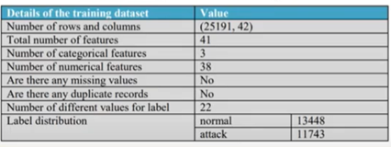
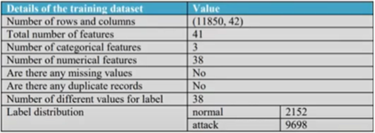

Slide 13
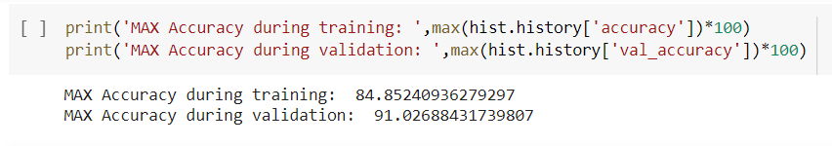
RESULTS OBTAINED:
NSL-KDD data set:
Test accuracy :91.026
Train accuracy :84.852

Slide 14
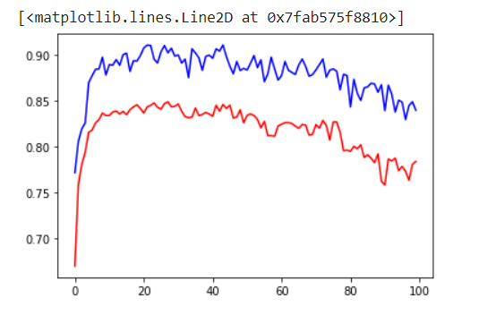
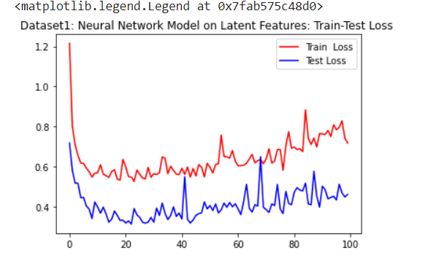
TRAIN(RED) AND TEST (BLUE) ACCURACY

Slide 15

FUTURE SCOPE:
To integrate the network and host based IDS for better detection.
Developing IDS schemes for detecting novel attacks rather than individual instantiations..
Monitors the operation of firewalls, routers, key management servers and files critical to other security mechanisms.
Allows administrator to tune, organize and comprehend often incomprehensible operating system audit trails and other logs.
Can make the security management of systems by non-expert staff possible by providing nice user friendly interface.
Can recognize and report alterations to data files.

Slide 16
CONCLUSION:
We observed that the model created using Deep neural network using the AutoEncoder layers as hidden layers has shown better results when compared to the results from model created using machine learning algorithms.
We want to further experiment using Generative Adversarial networks, type of neural networks and also perform experiments towards building an intrusion prevention system versus an intrusion detection system.

Slide 17
References: 1.Dataset: :https://www.unsw.adfa.edu.au/unsw-canberra-cyber/cybersecurity/ADFA-NB15-Datasets/ 2. Link: https://www.unb.ca/cic/datasets/nsl.html 3. B. Mukherjee, L. T. Heberlein and K. N. Levitt, "Network intrusion detection", IEEE Netw., vol. 8, pp. 26-41, May 1994. 4. D Larson, "Distributed denial of service attacks–holding back the flood", Netw. Secur., vol. 2016, no. 3, pp. 5-7, 2016. 5. R. C. Staudemeyer, "Applying long short-term memory recurrent neural networks to intrusion detection", South Afr. Comput. J., vol. 56, no. 1, pp. 136-154, 2015. 6. S. Venkatraman and M. Alazab, "Use of data visualisation for zero-day Malware detection", Secur. Commun. Netw., vol. 2018, Dec. 2018

Slide 18
THANK YOU

